Slide 1

Facial Expression Detection
DEPARTMENT OF COMPUTER SCIENCE AND ENGINEERING
Submitted By:-
Rajat Gupta - 12eskcs091
Prashant Kathuria - 12eskcs080
Tushar Mittal - 12eskcs120
Subroto Biswas - 12eskcs115
Project Mentor: Neha Janu
Project Guide: Deepti Khanduja

Slide 2
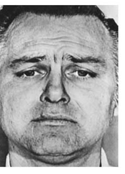
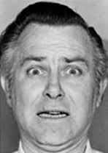
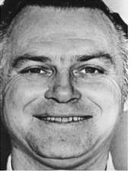
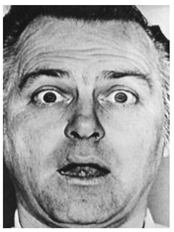
Problem Statement
To detect facial expression from a static image , this will mainly work to detect 4 expression i.e. Happy, Sad, Surprise, and Fear.
Tools used :- Matlab .
Algorithms :- Gabor Filter, Neural Network.

Slide 3
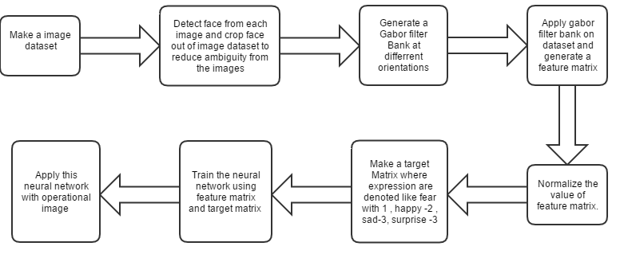
Flow Chart

Slide 4
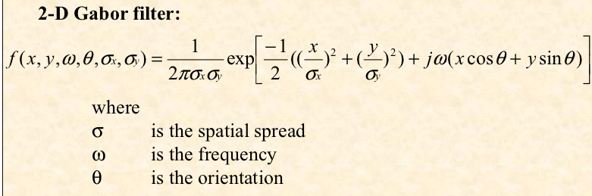
Gabor Filter

Slide 5
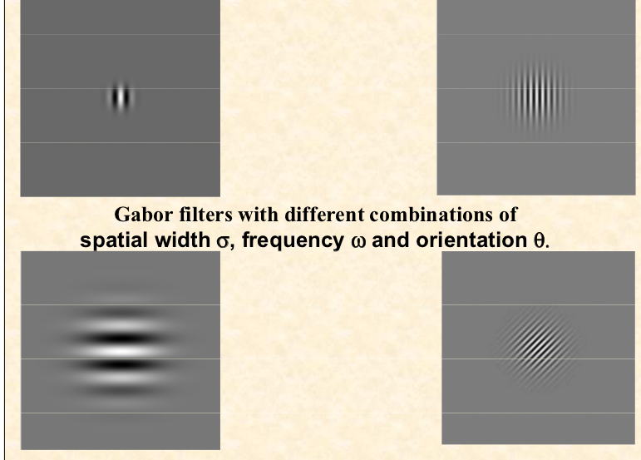

Slide 6
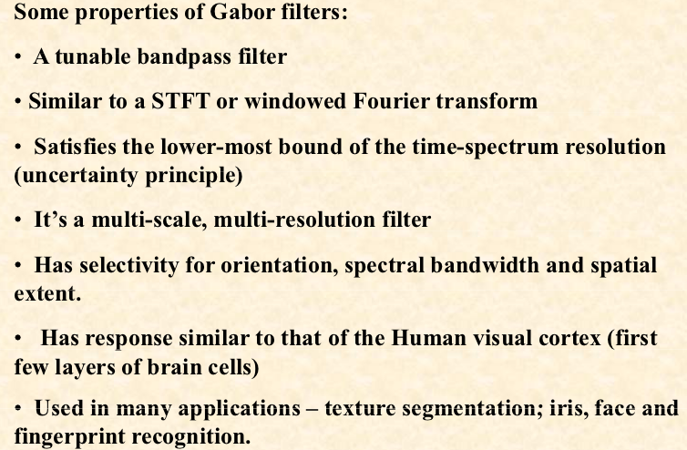

Slide 7
Image DataSet
Fear Happy Sad Surprise

Slide 8
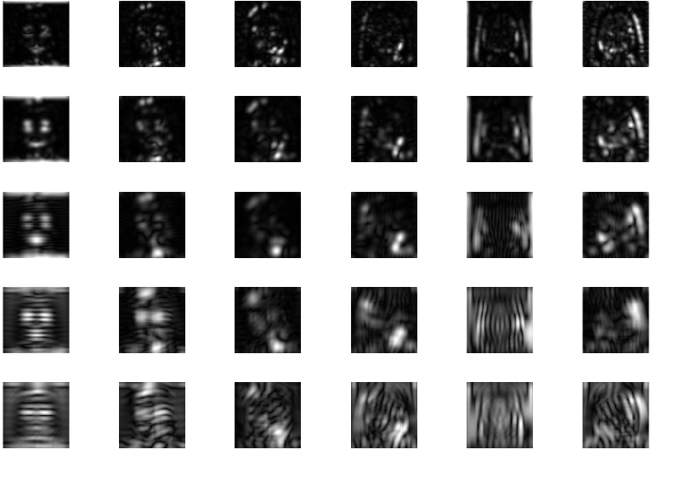
Magnitude of gabor filter

Slide 9
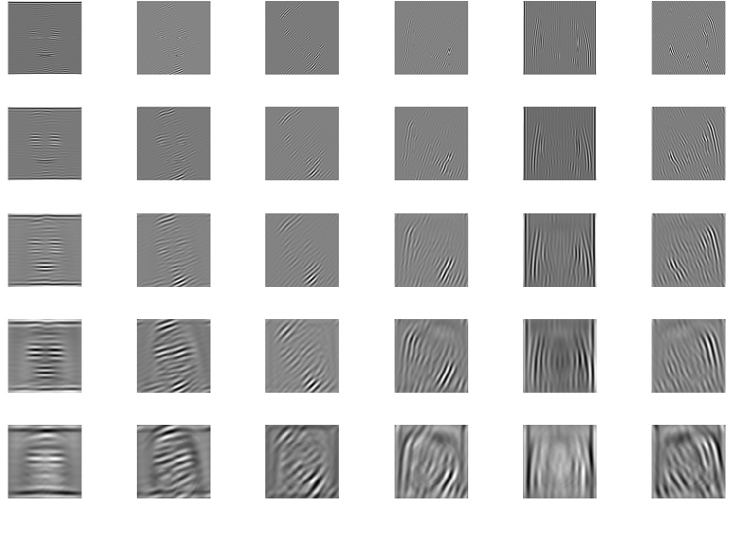
Real part of gabor filter

Slide 10
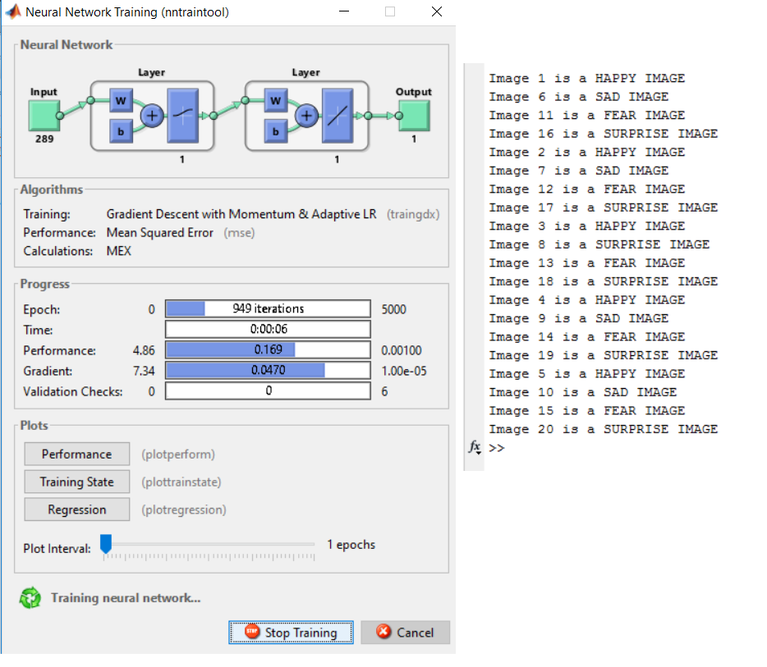

Slide 11
Conclusion
The project aimed at finding basic facial expressions like happy, sad , fear, surprise etc. of a static image using gabor filter
On a dataset of around 20 images we achieved an accuracy of 86% i.e. 17 expressions correct.
Future Work-
Apply averaging on gabor filter bank to reduce matrix size and redundancy
Apply DCT and DWT filters to increase efficiency
Find threshold for number of optimum features on an image

Slide 12
THANK YOU!

